Slide 1
The ARM Architecture (with focus on Cortex-M3) Joe Bungo Applications Engineer ARM University Program
Notes:
v10: 28/04/03, Chris Shore
slide 4: added China to text (already on graphic). Updated employee count and geographical distribution.
slide 19: added V6
slides 32: Imported from RV Overview to replace original ADS slide.
slide 33: New general debug architecture diagram
slide 34: new product montage (crib in notes)
slide 35: New question about embedded trace.
v09: 19/11/02, Chris Shore
slides 6-8: New slides showing IP deployment (imported from 926 core module)
v08: 08/02, Rob Levy
- Style update, black & white view amended
v07: 12/01, CJS
Main changes:
- ARM Development Boards slide removed (now in Debug Solutions module)
- Register set slides re-ordered so that the animated graphic comes first
- slide 12: Q bit in v5TEJ as well as v5TE
- slide 14: CPSR changes rephrased slightly
- slide 16: reference to v5T removed.
- slide 27: EASY/Micropack replaced with ADK/ACT
- slide 30: Trace slide updated

Slide 2
Agenda
Introduction to ARM Ltd
ARM Architecture/Programmers Model
Data Path and Pipelines
System Design
Development Tools
Notes:
Introduction to ARM
Background to who ARM Ltd are, what we do, and how our business model works.
Programmers Model
The structure of the ARM architecture
How it has developed
Register set, modes and exceptions
The endian issue
Instruction Sets
Overview of the features of the ARM instruction set
The coprocessor mechanism
Overview of Thumb - Why it was designed and the benefits it gives.
System Design
Overview of some of the hardware and software technologies that ARM has to support the design in of the ARM core into real products.
Also looks at some of the issues involved with memory maps in ARM based systems.

Slide 3
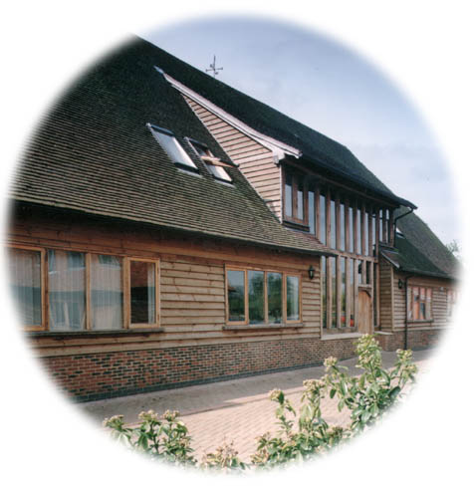
ARM Ltd
Founded in November 1990
Spun out of Acorn Computers
Initial funding from Apple, Acorn and VLSI
Designs the ARM range of RISC processor cores
Licenses ARM core designs to semiconductor partners who fabricate and sell to their customers
ARM does not fabricate silicon itself
Also develop technologies to assist with the design-in of the ARM architecture
Software tools, boards, debug hardware
Application software
Bus architectures
Peripherals, etc
Notes:
The ARM processor core originates within a British computer company called Acorn. In the mid-1980s they were looking for replacement for the 6502 processor used in their BBC computer range, which were widely used in UK schools. None of the 16-bit architectures becoming available at that time met their requirements, so they designed their own 32-bit processor.
Other companies became interested in this processor, including Apple who were looking for a processor for their PDA project (which became the Newton). After much discussion this led to Acorn’s processor design team splitting off from Acorn at the end of 1990 to become Advanced RISC Machines Ltd, now just ARM Ltd.
Thus ARM Ltd now designs the ARM family of RISC processor cores, together with a range of other supporting technologies.
One important point about ARM is that it does not fabricate silicon itself, but instead just produces the design - we are an Intellectual Property (or IP) company. Instead silicon is produced by companies who license the ARM processor design.

Slide 4


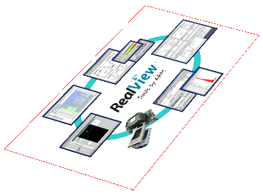
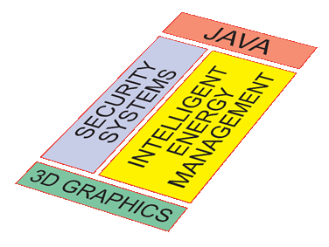
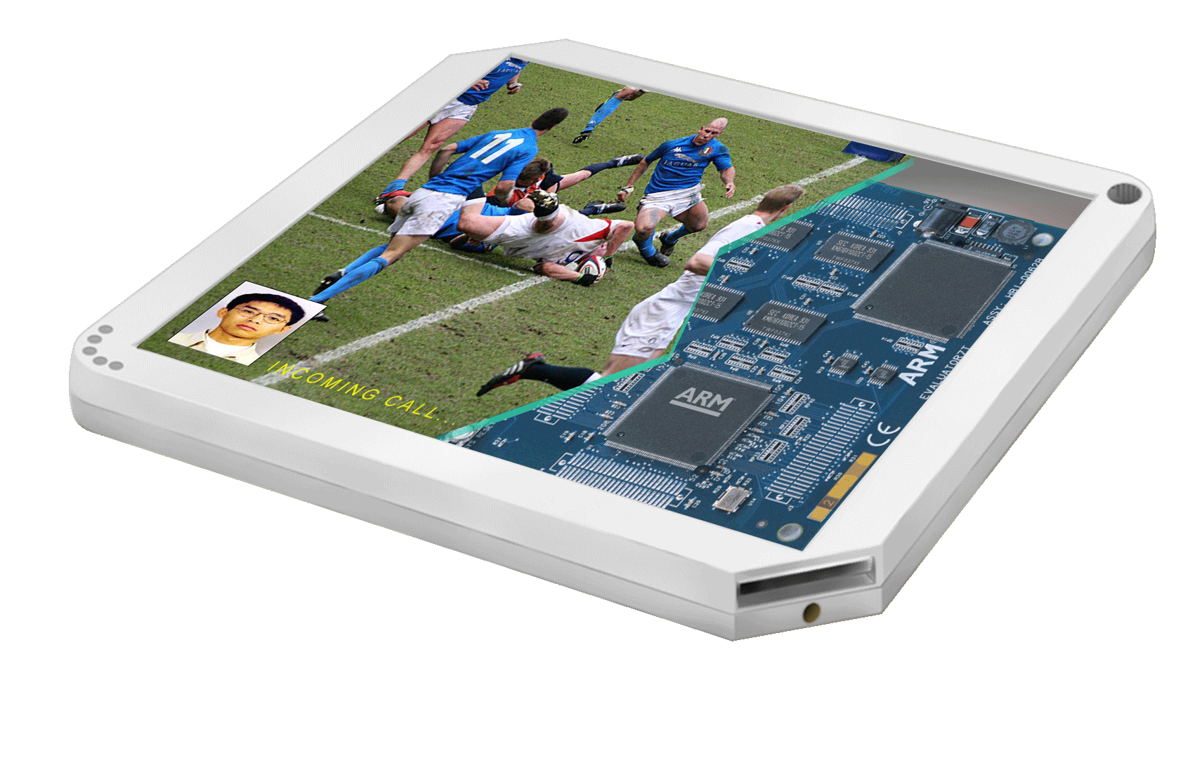

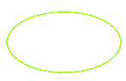
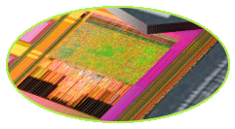
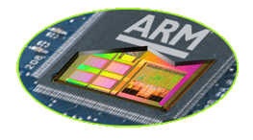
ARM’s Activities
Connected Community
Development Tools
Software IP
Processors
System Level IP:
Data Engines
Fabric
3D Graphics
memory
SoC
Physical IP
Notes:
The slide helps explain where ARM products play. A generic Digital product; ARM supplies system level IP into the SoC along with Physical IP to ensure its manufacturable;
Software IP into the system; Development tools to help design and build the system architecture and software.
Finally, we work with an extensive 3rd party community to make the whole device creation possible.
Remember this helps frame what we do not cover also, e.g. industrial design of the device.

Slide 5

ARM Connected Community – 700+
5
Notes:
5

Slide 6


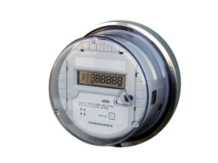

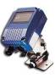




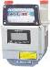

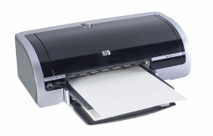


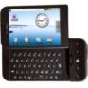

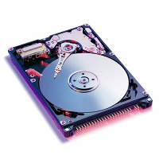
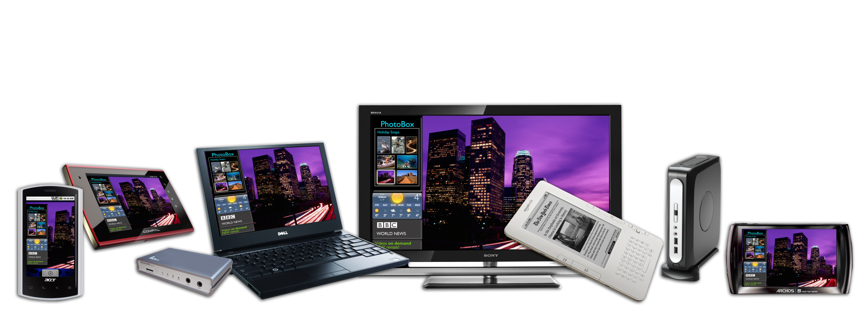


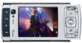
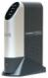
Huge Range of Applications
IR Fire Detector
Utility Meters
Exercise Machines
Intelligent Vending
Intelligent toys
Energy Efficient Appliances
Tele-parking
Equipment Adopting 32-bit ARM Microcontrollers
Notes:
6
6

Slide 7
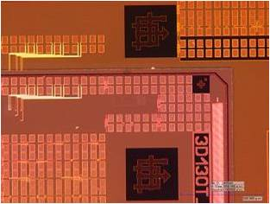
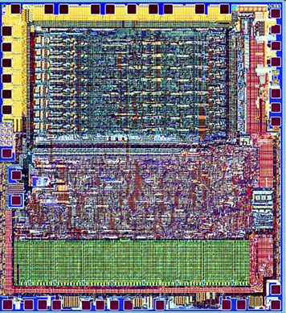
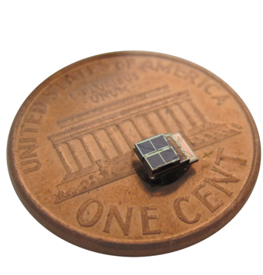
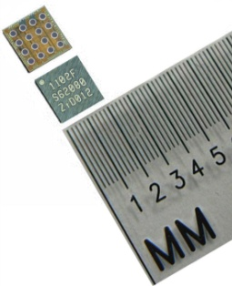

World’s Smallest ARM Computer?
Wireless Sensor Network
Sensors, timers
Cortex-M0 +16KB RAM 65nm
UWB Radio antenna
10 kB Storage memory ~3fW/bit
12µAh Li-ion Battery
A
B
C
Wirelessly networked into large scale sensor arrays
Cortex-M0; 65¢
University of Michigan
Notes:
Worlds smallest perpetual solar-powered sensor network at about a 1 cubic mm in size, for use in biomedical implants (so conceivably, could harvest energy by motion or heat instead of light) or maybe building or bridge monitoring.
Avg power consumption of the processor is under a nanowatt, or one-billionth of a watt
Not an off-the-shelf part, but they go for under a $1
7

Slide 8

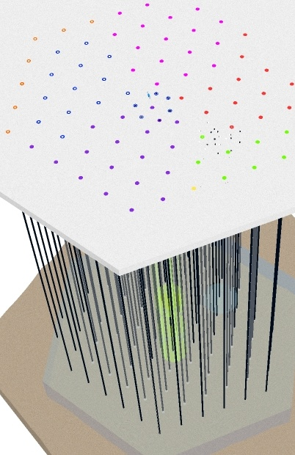

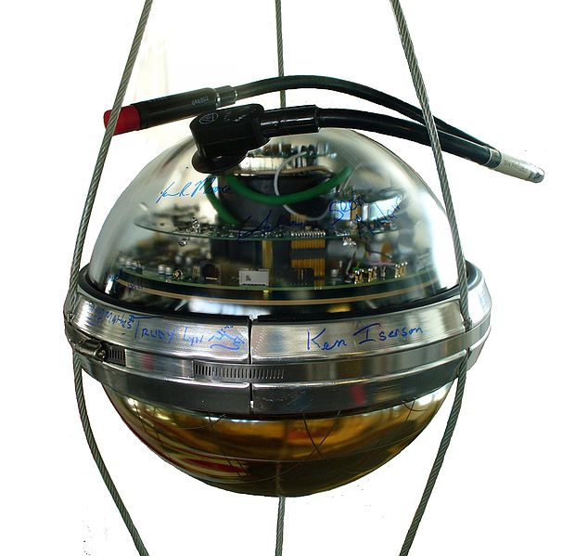
World’s Largest ARM Computer?
4200 ARM powered
Neutrino Detectors
70 bore holes 2.5km deep
60 detectors per string
starting 1.5km down
1km³ of active telescope
2.5km
1km
Work supported by the National Science Foundation and University of Wisconsin-Madison
Notes:
Neutrinos are particles similar to electrons, but have no electrical charge, and come from nuclear reaction from the sun or dark matter.
The system acts as a telescope to detect dark matter like supernovas and black holes in the universe.
Detector is about the size of a basketball
8

Slide 9
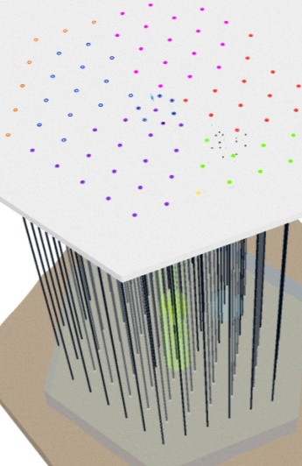
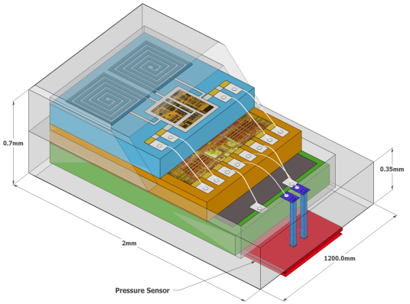
From 1mm³ to 1km³
0.35mm
1mm³
1km³
0.7mm
1.2mm
2mm
10¢
$1000
Mobile
Home
Mobile Computing
Server
Embedded
Consumer
Enterprise
PC
HPC
Notes:
9

Slide 10
Agenda
Introduction to ARM Ltd
ARM Architecture/Programmers Model
Data Path and Pipelines
System Design
Development Tools
Notes:
Programmers Model
The structure of the ARM architecture
How it has developed
Register set, modes and exceptions
The endian issue

Slide 11

ARM Cortex Processors (v7)
ARM Cortex-A family (v7-A):
Applications processors for full OS and 3rd party applications
ARM Cortex-R family (v7-R):
Embedded processors for real-time signal processing, control applications
ARM Cortex-M family (v7-M):
Microcontroller-oriented processors for MCU and SoC applications
...2.5GHz
x1-4
Cortex-A15
x1-4
Cortex-A9
Cortex-A8
x1-4
Cortex-A5
1-2
R
Heron
Cortex-R4
Cortex-M4
SC300™
Cortex™-M3
Cortex-M1
12k gates...
Cortex-M0
Notes:
Version 7 of the instruction set architecture coincided with the introduction of the Cortex product naming convention.
Cortex processors are named based on how they are used (letter), along with a qualitative numeric indicator of performance and functionality.
This slide shows the 3 families along with the processor designs we have in hand today and can deliver tomorrow.
-------------
Hardware virtualization is when the virtual machine manager is embedded in the circuits of a hardware component instead of being called up from a third-party software application. The virtual machine manager is called a hypervisor.
The job of the hypervisor is to control processor, memory and other firmware resources. The hypervisor acts like a traffic cop, allowing multiple operating systems to run on the same device without requiring source code or binary changes. Each operating system appears to have the processor, memory, and other firmware resources all to itself -- but in reality, the hypervisor is controlling the processor and its resources, allocating what is needed to each operating system in turn.
Hardware virtualization is an evolving technology that may become dominant, especially for server platforms, because it has the potential to facilitate the consolidation of multiple workloads on a single physical server without requiring third-party software.

Slide 12
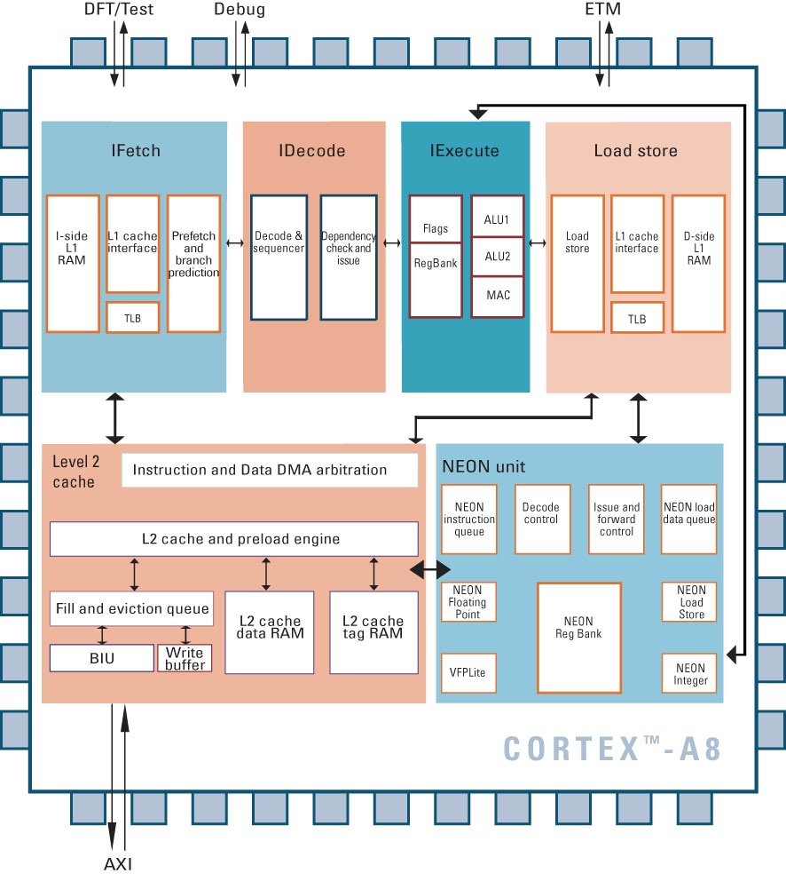
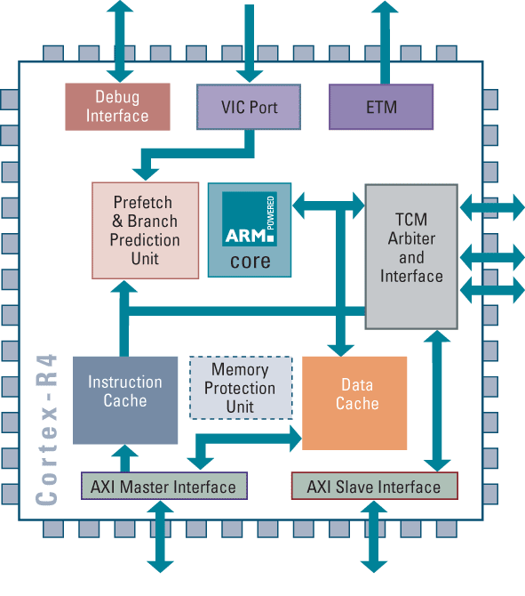
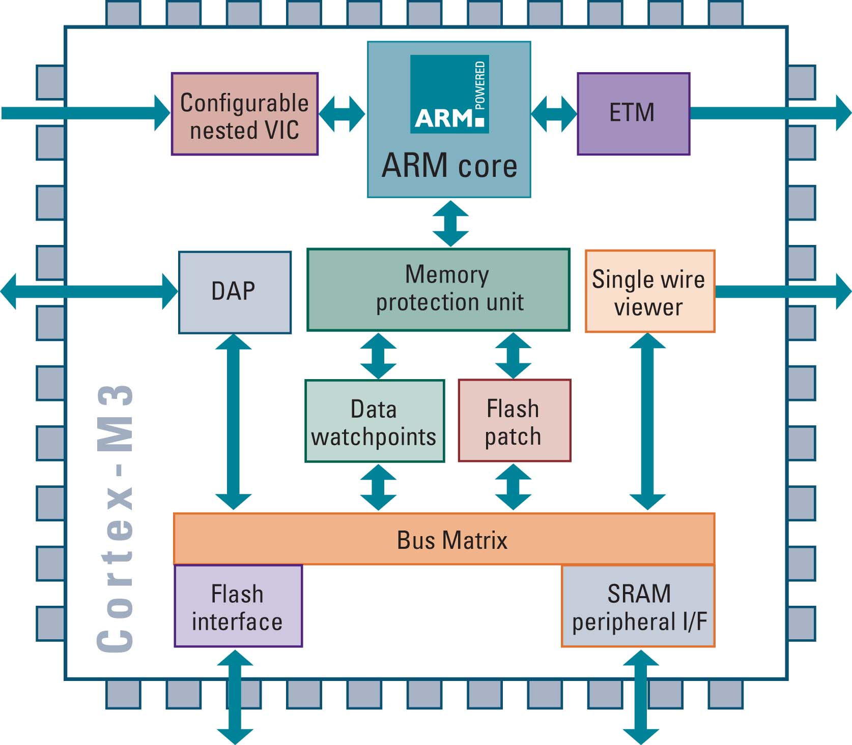
Cortex family
Cortex-A8
Architecture v7A
MMU
AXI
VFP & NEON support
Cortex-R4
Architecture v7R
MPU (optional)
AXI
Dual Issue
Cortex-M3
Architecture v7M
MPU (optional)
AHB Lite & APB

Slide 13
Relative Performance*
*Represents attainable speeds in 130, 90, 65, or 45nm processes

Slide 14
Data Sizes and Instruction Sets
The ARM is a 32-bit architecture.
When used in relation to the ARM:
Byte means 8 bits
Halfword means 16 bits (two bytes)
Word means 32 bits (four bytes)
Most ARM’s implement two instruction sets
32-bit ARM Instruction Set
16-bit Thumb Instruction Set
Jazelle cores can also execute Java bytecode
Notes:
The cause of confusion here is the term “word” which will mean 16-bits to people with a 16-bit background.
In the ARM world 16-bits is a “halfword” as the architecture is a 32-bit one, whereas “word” means 32-bits.
Java bytecodes are 8-bit instructions designed to be architecture independent. Jazelle transparently executes most bytecodes in hardware and some in highly optimized ARM code. This is due to a tradeoff between hardware complexity (power consumption & silicon area) and speed.

Slide 15
ARM and Thumb Performance
Dhrystone 2.1/sec
@ 20MHz
Memory width (zero wait state)
Notes:
Intention
To show a comparison of memory usage between ARM and thumb instructions when running from different size memory width.
In 16-bit memory, Thumb code is better. Even though there are more instructions, each instruction only take a single cycle to fetch whereas each ARM instruction now takes two cycles to fetch.
However you can see in the 16-bit example that the performance from Thumb has gone down -despite still taking a single cycle to fetch each instruction. This is because of data accesses, and in particular stack accesses. Even in Thumb, each access to the stack will be a 32-bit quantity (as register contents are transferred - and this lowers performance on a full 16-bit memory architecture.
One way around this is to provide a limited amount of 32-bit memory to place you stack in - which can give a useful performance boost. In this case the boost gets performance almost back to the full 32-bit performance level. The difference is due to the Dhrystone benchmark using integer (32-bit) global data which is still being stored in 16-bit wide memory.

Slide 16
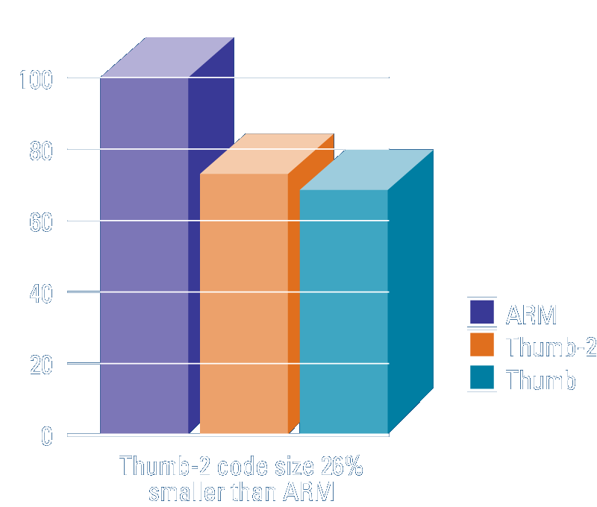
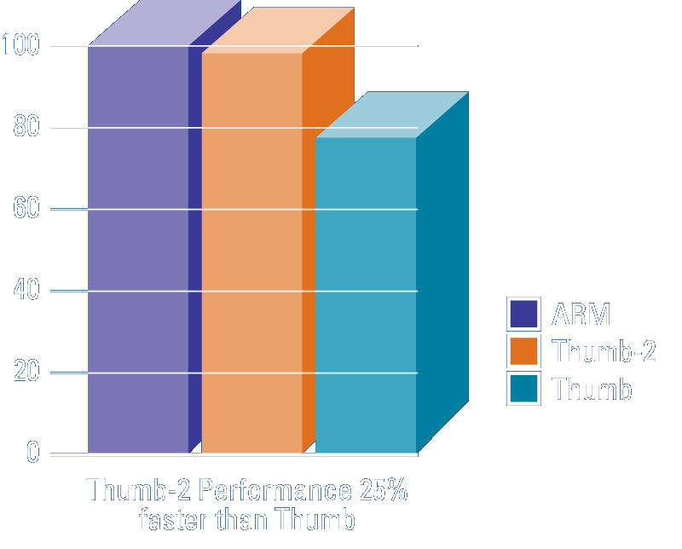
The Thumb-2 instruction set
Variable-length instructions
ARM instructions are a fixed length of 32 bits
Thumb instructions are a fixed length of 16 bits
Thumb-2 instructions can be either 16-bit or 32-bit
Thumb-2 gives approximately 26% improvement in code density over ARM
Thumb-2 gives approximately 25% improvement in performance over Thumb
Notes:
In fact, Cortex-M3 implements only a SUBSET of the Thumb-2 instruction set.

Slide 17
Cortex-M Programmer’s Model
Fully programmable in C
Stack-based exception model
Only two processor modes
Thread Mode for User tasks
Handler Mode for OS tasks and exceptions
Vector table contains addresses
Main
r0
r1
r2
r3
r4
r5
r6
r7
r8
r9
r10
r11
r12
Process
sp
sp
lr
r15 (pc)
xPSR
Notes:
- It’s fully programmable in C, so programmers need to know nothing about ARM assembly, as opposed to previous ARM processors where you had to use assembly to use some specific instructions because compiler can’t generate them (ie. Atomic swap, or CLZ), or access PSRs to do things like enable/disable interrupts.
Stack-based programmer’s and exception model, more analogous to traditional 8- and 16-bit architectures, so it’s aimed at designers coming from that background. Stack-based means PC, PSR, LR, and corruptible registers automatically pushed onto stack upon exceptions in hardware, as opposed to manually doing it in software for other ARM processors.
Vector table contains addresses that are fetched upon accepting interrupts as opposed to instructions.
Two modes means less initialization code

Slide 18
Cortex-M3 Processor Privilege
ARM Cortex-M3
Privileged
Supervisor
Aborts
Interrupts
Reset
Handler Mode
OS
System Call (SVCall)
Undefined Instruction
User
Non-Privileged
Thread Mode
Application code
Memory
Instructions & Data
Notes:
As mentioned, the M3 supports two operating modes, called Thread and Handler modes, which can be thought of as dividing the system into a Supervisor and a User modes. These are actually the terms used for the modes on ARM processors.
Further, the M3 supports two levels of access for code, privileged and unprivileged. The two-level access for code enables the implementation of complex, open systems without sacrificing security of the application. Unprivileged code limits or excludes access to some resources such as specific instructions or memory locations.
So the User sides where most application code runs, and supports non-privileged and privileged code. The Supervisor side supports only privileged code.
Exceptional events, such as operating systems calls, for example, to allocate memory or perform some other OS task, or error conditions like undefined instructions are the only way to go from the User side to the Supervisor side.
Other exception events are external and include things like memory aborts, interrupts, and Resets.
And again, the technical term for these two modes or operation are Thread and Handler.

Slide 19
Cortex-M3 Interrupt Handling
One Non-Maskable Interrupt (INTNMI) supported
1-240 prioritizable interrupts supported
Interrupts can be masked
Implementation option selects number of interrupts supported
Nested Vectored Interrupt Controller (NVIC) is tightly coupled with processor core
Interrupt inputs are active HIGH
INTNMI
Cortex-M3 Processor Core
NVIC
1-240 Interrupts
INTISR[239:0]
…
Cortex-M3
Notes:
So here’s what the NVIC looks like next to the core. Again, this is traditionally off the processor, but not with the M3.
NMI usually used for unrecoverable hardware errors, and so should never be ignored (ie data corruption or parity errors) and may cause a debug monitor program to be executed
The number of interrupts supported can be configured depending on implementation.
The ‘N’ means interrupts can be nested or stacked, allowing pending higher priority interrupts to be serviced first.
The NVIC also supports dynamic re-prioritization, so priorities can change at runtime by software.
It also supports something called Tail-chaining that replaces typically high-latency serial push/pop actions with a low-latency instruction fetch between the ISRs. This allows the need for only one set of push/pop operations for back-to-back interrupts instead of a set for every interrupt.

Slide 20
Cortex-M3 Exception Handling
Reset : power-on or system reset
NMI : cannot be stopped or preempted by any exception other than reset
Faults
Hard Fault : default Fault or any fault unable to activate
Memory Manage : MPU violations
Bus Fault : prefetch and memory access violations
Usage Fault : undef instructions, divide by zero, etc.
SVCall : privileged OS requests
Debug Monitor : debug monitor program
PendSV : pending SVCalls
SysTick Interrupt : internal sys timer, i.e., used by RTOS to periodically check resources or peripherals
External Interrupt : i.e., external peripherals
Notes:
So these are the types of exceptions. They appear in a similar order in the vector table with a few differences. Some of these look similar to traditional ARM exceptions, like Reset, Memory Aborts, and Supervisor exceptions. When an exception occurs, the vector is automatically fetched from the vector table in parallel with the state save.
Reset..
NMI cannot be stopped or preempted by any exception other than reset
A Hard Fault can be any class of fault that can’t activate for some reason, perhaps the Fault handler has been disabled or it doesn’t have enough priority to execute. In fact, in simple systems, all faults use the Hard Fault handler.
Mem Management fault for MPU violations
Bus Fault are for prefetch and memory access violations
Usage Fault include executing undefined instructions, trying to execute instructions in an invalid state, or divide by zero for example
Debug Monitor is where you would hold a debug monitor program for debug in Monitor Mode, which again allows you to continue servicing prioritirized interrupts in real-time
SVCall is usually used for operating system requests, for example, memory allocations or starting other OS tasks
PendSV are for pending SVCalls. SVCalls and PendSVs work together to allow OS to switch contexts without masking interrupts.
External Interrupt are for any interrupt external to the M3, maybe you have an external keyboard/mouse controller, or extern USB interface
SysTick is for the internal system timer, usually used by an RTOS to periodically check some resource or peripheral, or call some other code.. The advantage of it being internal is that any M3-based microcontroller will use this timer in the exact same way, so Timer code won’t have to be re-written. This is in addition to the fact that you don’t have to get the tick from a peripheral off the M3.
--------------
On the Nintendo Entertainment System, an NMI is generated during each vertical blanking interval. Because these NMIs (often referred to as "vblank interrupts") occur at frequent, regular intervals, code that manipulates game graphics and audio is often executed inside of the NMI handler routine

Slide 21
Cortex-M3 Program Status Register
One Status Register consisting of
APSR - Application Program Status Register – ALU flags
IPSR - Interrupt Program Status Register – Interrupt/Exception No.
EPSR - Execution Program Status Register
IT field – If/Then block information
ICI field – Interruptible-Continuable Instruction information
xPSR
Composite of the 3 PSRs
Stored on the stack on exception entry
31
28
27
26
25
24
23
16
15
10
7
0
IT
T
IT/ICI
ISR Number
N Z C V Q
Notes:
So the PSR is one register that can be broken up into 3 subsets of bit fields:
…
- ICI field mostly used to hold core register number that was last transferred when an LDM/STM instruction was interrupted so it doesn’t have to restart.

Slide 22
Conditional Execution
If – Then (IT) instruction added (16 bit)
Up to 3 additional “then” or “else” conditions maybe specified (T or E)
Makes up to 4 following instructions conditional
ITTET EQ
Inst 1
Inst 2
Inst 3
Inst 4
MOVEQ
ADDEQ
SUBNE
ORREQ
Any normal ARM condition code can be used
16-bit instructions in block do not affect condition code flags
Apart from comparison instruction
32 bit instructions may affect flags (normal rules apply)
Current “if-then status” stored in CPSR
Conditional block maybe safely interrupted and returned to
Must NOT branch into or out of ‘if-then’ block
Notes:
One previous limitation of 16-bit thumb instructions was the inability to perform conditional execution In Thumb2, we have a new 16-bit If-Then instruction for doing so.
The 16-bit instruction looks like so, and in this example, it says “If EQ condition (or Z flag in PSR) is true, Then execute instruction 1 and 2, Else execute instruction 3, and Then execute instruction 4.
Any CC can be used, however, 16-bit instructions inside the block cannot set flags with the exception of the comparison instruction.
Special IT status bits in PSR so a block can be safely interrupted and returned to, otherwise, the IT condition wouldn’t be know. And you should not branch into or out of the block (unless it’s the last instruction of the block), because again, the instructions would have no knowledge of the IT condition since PSR is not pushed/popped upon branches.

Slide 23
Classes of Instructions (v4T)
Load/Store
Miscellaneous
Data Operations
Change of Flow
MOV PC, Rm
Bcc
BL
BLX

Slide 24
Data processing Instructions
Consist of :
Arithmetic: ADD ADC SUB SBC RSB RSC
Logical: AND ORR EOR BIC
Comparisons: CMP CMN TST TEQ
Data movement: MOV MVN
These instructions only work on registers, NOT memory.
Syntax:
<Operation>{<cond>}{S} Rd, Rn, Operand2
Comparisons set flags only - they do not specify Rd
Data movement does not specify Rn
Second operand is sent to the ALU via barrel shifter.
Notes:
BIC bit clear
ORR bit set
AND bit mask
EOR bit invert
Comparisons produce no results - just set condition codes.
CMP like SUB
CMN like ADD (subtract of a negative number is the same as add)
TST like AND
TEQ like EOR (eor of identical numbers gives result of zero)
Generally single-cycle execution (except write to PC and register-controlled shift). Mention ARM NOP & Thumb NOP.
Explain RSB and RSC which do subtract in other order (e.g. y-x not x-y)
Does not include multiply (separate instr format). No divide - compiler uses run-time library or barrel shifter to perform division.
Can combine “S” bit with conditional execution, e.g.
ADDEQS r0, r1, r2

Slide 25
Using a Barrel Shifter:The 2nd Operand
Register, optionally with shift operation
Shift value can be either be:
5 bit unsigned integer
Specified in bottom byte of another register.
Used for multiplication by constant
Immediate value
8 bit number, with a range of 0-255.
Rotated right through even number of positions
Allows increased range of 32-bit constants to be loaded directly into registers
Operand 1
Operand 2
Barrel Shifter
ALU
Result
Notes:
Mention A bus and B bus on 7TDMI core.
Give examples:
ADD r0, r1, r2
ADD r0, r1, r2, LSL#7
ADD r0, r1, r2, LSL r3
ADD r0, r1, #0x4E

Slide 26
Single register data transfer
LDR STR Word
LDRB STRB Byte
LDRH STRH Halfword
LDRSB Signed byte load
LDRSH Signed halfword load
Memory system must support all access sizes
Syntax:
LDR{<cond>}{<size>} Rd, <address>
STR{<cond>}{<size>} Rd, <address>
e.g. LDREQB
Notes:
Point out destination (reg) first for LDR, but destination (mem) last for STR. Different to Motorola, but it keeps the instruction mnemonic format consistent. Always have register loaded/stored first, then address accessed second
Size specifier comes out on MAS (memory access size) signal. Important that memory supports full range of accesses - especially important for writes where only the specified size should be written.
Special types of sign extended load - this is needed because ARM registers only hold 32-bit values. Draw diagram. No need for special store instructions though.
Instruction cycle timing:
STR LDR
7TDMI 2 cycles 3 cycles
9TDMI 1 cycle 1 cycle - interlock if used in next cycle
StrongARM1 1 cycle 1 cycle - interlock if used in next cycle
Xscale 1 cycle 1 cycle - interlock if used in next 2 cycles
Note size specifier comes after condition code.
Link: <address> explained on next slide.
Note that load/store instructions never set condition codes.

Slide 27
Agenda
Introduction to ARM Ltd
ARM Architecture/Programmers Model
Data Path and Pipelines
System Design
Development Tools
Notes:
Instruction Sets
Overview of the features of the ARM instruction set
The coprocessor mechanism
Overview of Thumb - Why it was designed and the benefits it gives.

Slide 28
Cortex-M3 Datapath
I_HRDATA
Instruction
Decode
Write Data
Register
D_HWDATA
Address
Incrementer
Read Data
Register
D_HRDATA
D_HADDR
Address
Register
B
Address
Incrementer
Register
Bank
Mul/Div
Barrel
Shifter
I_HADDR
ALU
A
ALU
Address
Register
Writeback
INTADDR
Notes:
The Cortex M3 is based on a Harvard architecture, so there are separate instruction and data buses.
Instructions come in along the AHB instruction read bus to the decode stage. I_HADDR is the Address bus on the instruction side bus.
So there are separate read data and write data registers and a data address bus.
Now the M3 is also considered to be a LDR-STR architecture, so all data processing is performed on registers, not directly on memory locations. So we can say something like ADD r0, r1, r1, LSL#2. R1 comes along both A and B buses (2nd operand through barrel shifter so we can do something like..)…
This diagram refers to the internal core, therefore only has I and D ports. Mapping to Icode, DCode and System spaces is performed outside the integer core by the FPB Unit and Bus Interface.

Slide 29
Cortex-M3 Pipeline
Cortex-M3 has 3-stage fetch-decode-execute pipeline
Similar to ARM7
Cortex-M3 does more in each stage to increase overall performance
1st Stage - Fetch
2nd Stage - Decode
3rd Stage - Execute
AGU
Address Phase & Write Back
Data Phase Load/Store & Branch
Write
Fetch (Prefetch)
Instruction Decode & Register Read
Multiply & Divide
Branch
Shift
ALU & Branch
Branch forwarding & speculation
Execute stage branch (ALU branch & Load Store Branch)
Notes:
So the M3 has a 3-stage pipe similar to an ARM7, but more is done in each stage to increase performance and is optimized for performance at low clock speeds.
A prefetch unit fetches instructions in advance and can buffer up to three 32-bit instructions or six 16-bit instructions, or a combination.
For direct branches (address or label vs. register), It does what’s called Branch Forwarding where in decode, it can fetch both possible instructions following a conditional branch (the fall through instruction and the branch target instruction) (point to first dotted). Then in execute, the branch is resolved and if the branch is not to be taken, the next instruction is already available. If the branch is to be taken, the branch instruction is made available at the same time as the decision is made, resulting in a single idle cycle. In an ARM7, branches always flush the pipe and usually cost 3 cycles.
CM3 runs at bus speed – you must fetch instructions at CPU clock speed, mostly without wait states.
These two points may limit how fast you can push the CM3 in any particular process.

Slide 30
ARM10 vs. ARM11 Pipelines
ARM10
Branch
Prediction
ARM or
Thumb
Instruction
Decode
Reg Read
Shift + ALU
Memory
Access
Reg
Write
Instruction
Fetch
Multiply
Multiply Add
FETCH
ISSUE
DECODE
EXECUTE
MEMORY
WRITE
ARM11
Shift
ALU
Saturate
Write
back
Fetch
1
Fetch
2
Decode
Issue
MAC
1
MAC
2
MAC
3
Address
Data
Cache
1
Data
Cache
2
Notes:
ARM10 - It just illustrates that another stage was added to the ARM9’s pipeline to provide additional time to handle coprocessor instruction decode and handle branch prediction. The Multiplier is now broken up over two stages, execute and memory, since the multiplier is also pipelined.
Note that the ARM9E multiplier is also pipeline (like ARM10) so the upper diagram strictly only applies to the ARM9TDMI.
ARM11 - The processor is a single issue processor, meaning that only one instruction per cycle can be issued from the issue stage to one of the 3 backend pipeline stages.
While the instructions are issued in order they may complete out of order. This will be depend on availability of data, length of execution and memory access times. ADD NOTES

Slide 31
Full Cortex-A8 Pipeline Diagram
13-Stage Integer Pipeline
10-Stage NEON Pipeline
Notes:
The Cortex-A8 is based on a dual, symmetric, in-order issue, 13-stage pipeline with advanced dynamic branch prediction. The ability to issue two data processing instructions at the same time increases the maximum potential instructions executed per cycle. In-order issue keeps the power required to a minimum.
The dual ALU pipelines (ALU PIPE0 and ALU PIPE1) are symmetric and both can handle most arithmetic instructions, with ALU pipe 0 always carries the older of a pair of issued instructions.
The Cortex-A8 also has multiplier and load-store pipelines, but these do not carry additional instructions to the two ALU pipelines. These can be thought of as “dependent” pipelines, meaning their use requires simultaneous use of one of the ALU pipelines.
To minimize the branch penalties typically associated with a deeper pipeline, the Cortex-A8 implements a two-level global history branch predictor consisting of two buffers which are accessed in parallel with instruction fetches.
And then you can see the NEON pipeline bolted onto the integer pipeline. Again, NEON is a 64/128-bit hybrid SIMD-based architecture for accelerating signal processing and multimedia codecs like H.264 and MP3. The NEON unit is decoupled from the A8’s integer pipeline by a separate NEON instruction queue. The A8 Instruction Execute Unit can issue up to two valid instructions to the NEON unit per cycle. The idea is that with traditional media processors from ARM (such as ARM11), you had the OS and video codec running on the integer pipe, and the graphics and game physics running on a separate VFP. With NEON, you can use both integer and floating point processing on the same processor, which gives you better data throughput and compiler optimization.
F0 is not counted as a stage as it is used only for address generation by the branch predictor
BIU = Bus Interface Unit - handles bus transactions between a processor core and external memories, and handles the caches. As an example, if there's a cache miss, the request goes out to an L2 cache. In the case of a further miss in the L2 cache, it goes out to external memory (DRAM, L3 system), so the BIU handles the requests going from the core (including L2) to the outside world.

Slide 32
Agenda
Introduction to ARM Ltd
ARM Architecture/Programmers Model
Data Path and Pipelines
System Design
Development Tools
Notes:
System Design
Overview of some of the hardware and software technologies that ARM has to support the design in of the ARM core into real products.
Also looks at some of the issues involved with memory maps in ARM based systems.

Slide 33
An Example AMBA System
High Performance
ARM processor
APB
UART
High
Bandwidth
External
Memory
Interface
APB
Bridge
Timer
AHB
Keypad
High-bandwidth
on-chip RAM
DMA
Bus Master
PIO
Low Power
Non-pipelined
Simple Interface
High Performance
Pipelined
Burst Support
Multiple Bus Masters
Notes:
AMBA systems are based around two buses, a high performance system bus and a lower performance peripheral bus.
The high performance bus (AHB) should connect all of the high performance, high bandwidth modules, such as the ARM Processor, any DMA engines, perhaps some fast, 32 bit wide local RAM (or wider to suit the ARM Bus Master being used), an external memory interface, and the interface to the lower performance bus. The number of modules connected here should be kept to a minimum to reduce the bus loading on this high performance bus and allow it to run much faster.
The bulk of the design modules are placed on the lower performance Peripheral Bus (APB). Modules placed here are not accessed as frequently as AHB modules, and as a result of the APB timing, need not consume power (in their APB interfaces) when there is no APB activity. The address and data bus widths on the APB only need to be as wide as required, compared to the AHB where the maximum address and data widths are specified to maximize system performance in this critical area.
So when a design is being partitioned, the main design criteria are
AHB APB
High Performance Low Power
Frequent Access Simple Interface
Pipelined timing Non-pipelined
We don’t go into multi-layer AHB, AHB Lite or any other AMBA configurations in this presentation.

Slide 34
Agenda
Introduction to ARM Ltd
ARM Architecture/Programmers Model
Data Path and Pipelines
System Design
Development Tools
Notes:
System Design
Overview of some of the hardware and software technologies that ARM has to support the design in of the ARM core into real products.
Also looks at some of the issues involved with memory maps in ARM based systems.

Slide 35
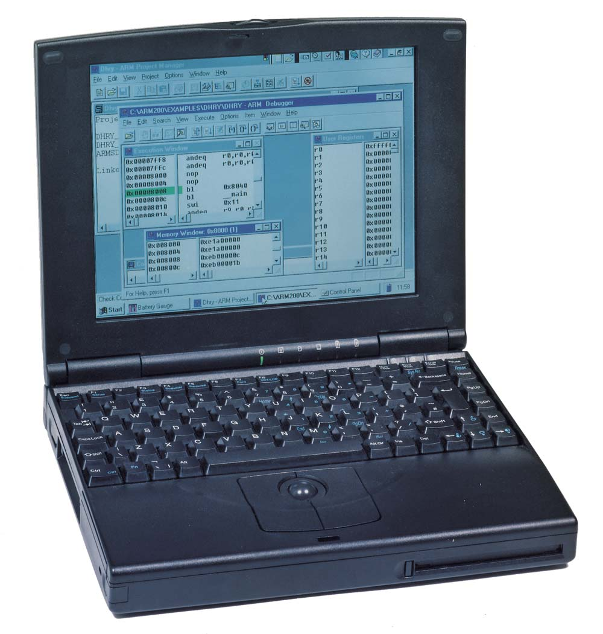
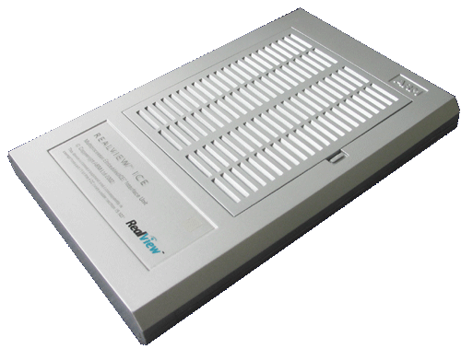
ARM Debug Architecture
Ethernet
Debugger (+ optional
trace tools)
EmbeddedICE Logic
Provides breakpoints and processor/system access
JTAG interface (ICE)
Converts debugger commands to JTAG signals
Embedded trace Macrocell (ETM)
Compresses real-time instruction and data access trace
Contains ICE features (trigger & filter logic)
Trace port analyzer (TPA)
Captures trace in a deep buffer
JTAG port
Trace Port
ARM
core
ETM
TAP
controller
EmbeddedICE
Logic
Notes:
Debugger trace tools
Have copy of the code image
Configure ETM trace via JTAG
Receive compressed trace from ETM
Decompress ETM trace using code image

Slide 36

Keil Development Tools for ARM
Includes ARM macro assembler, compilers (ARM RealView C/C++ Compiler, Keil CARM Compiler, or GNU compiler), ARM linker, Keil uVision Debugger and Keil uVision IDE
Keil uVision Debugger accurately simulates on-chip peripherals (I²C, CAN, UART, SPI, Interrupts, I/O Ports, A/D and D/A converters, PWM, etc.)
Evaluation Limitations
16K byte object code + 16K data limitation
Some linker restrictions such as base addresses for code/constants
GNU tools provided are not restricted in any way
http://www.keil.com/demo/

Slide 37
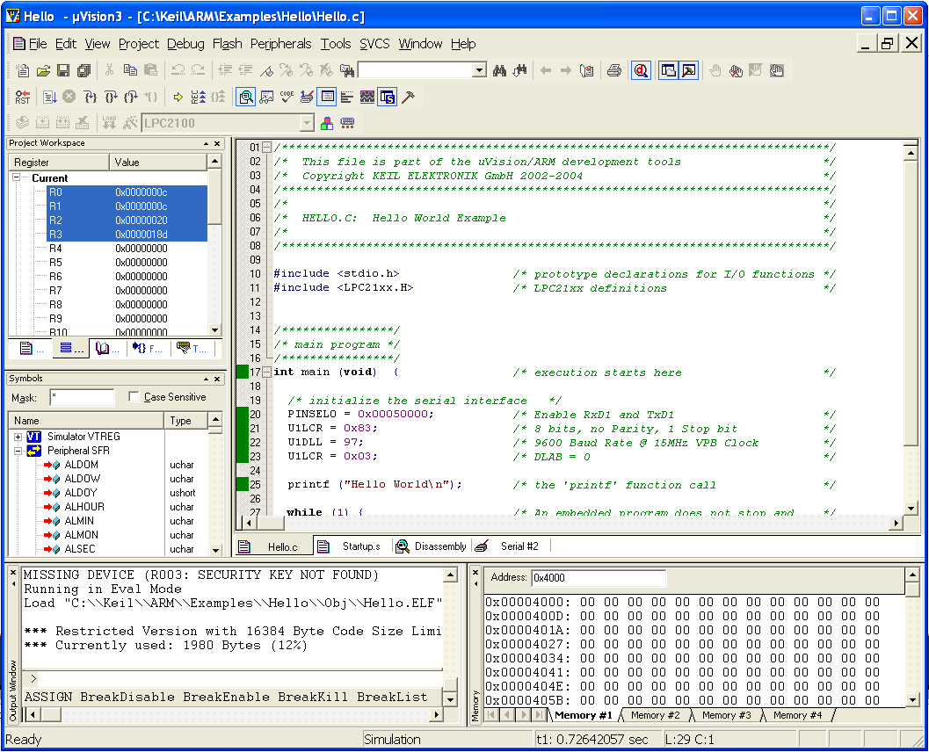
Keil Development Tools for ARM

Slide 38
University Resources
http://www.arm.com/support/university/
University@arm.com

Slide 39
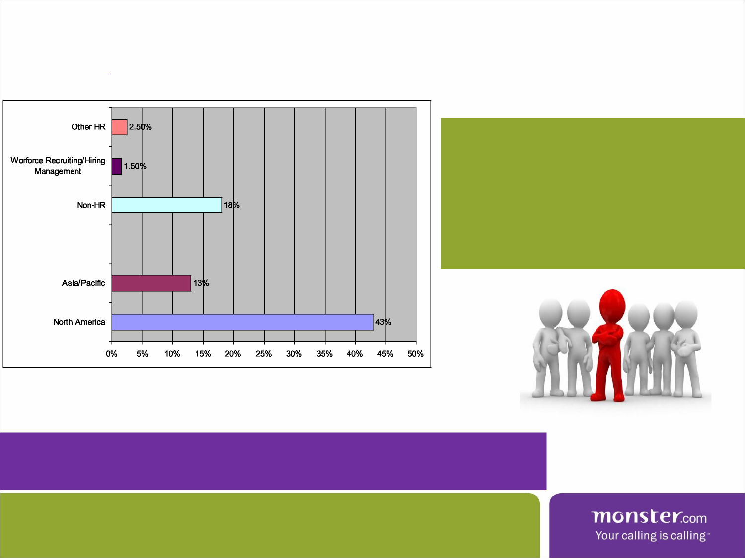
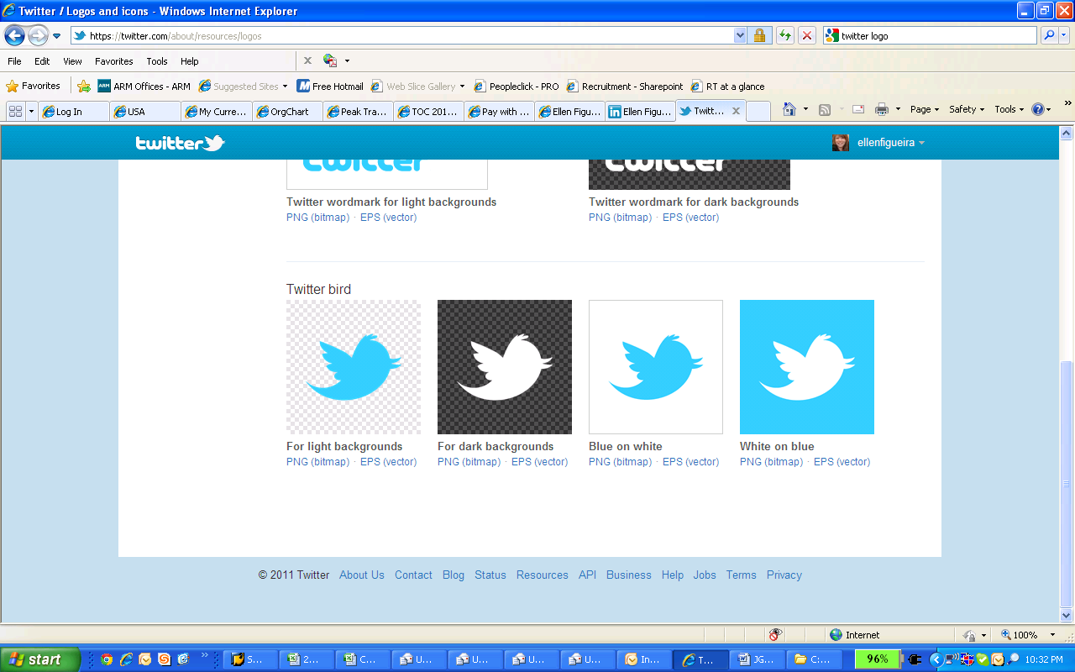
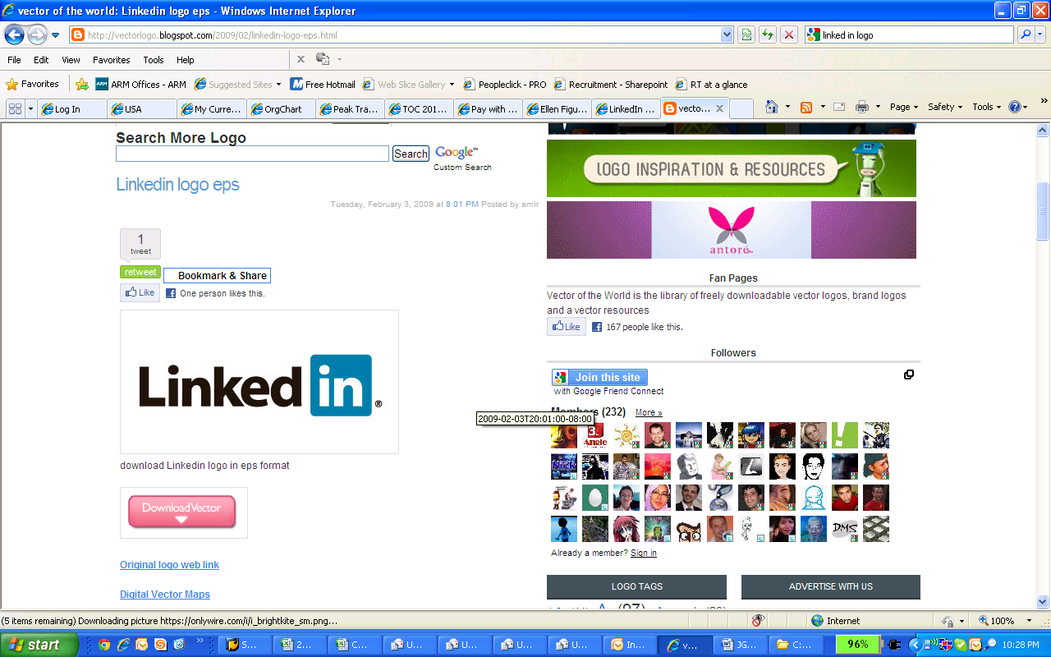
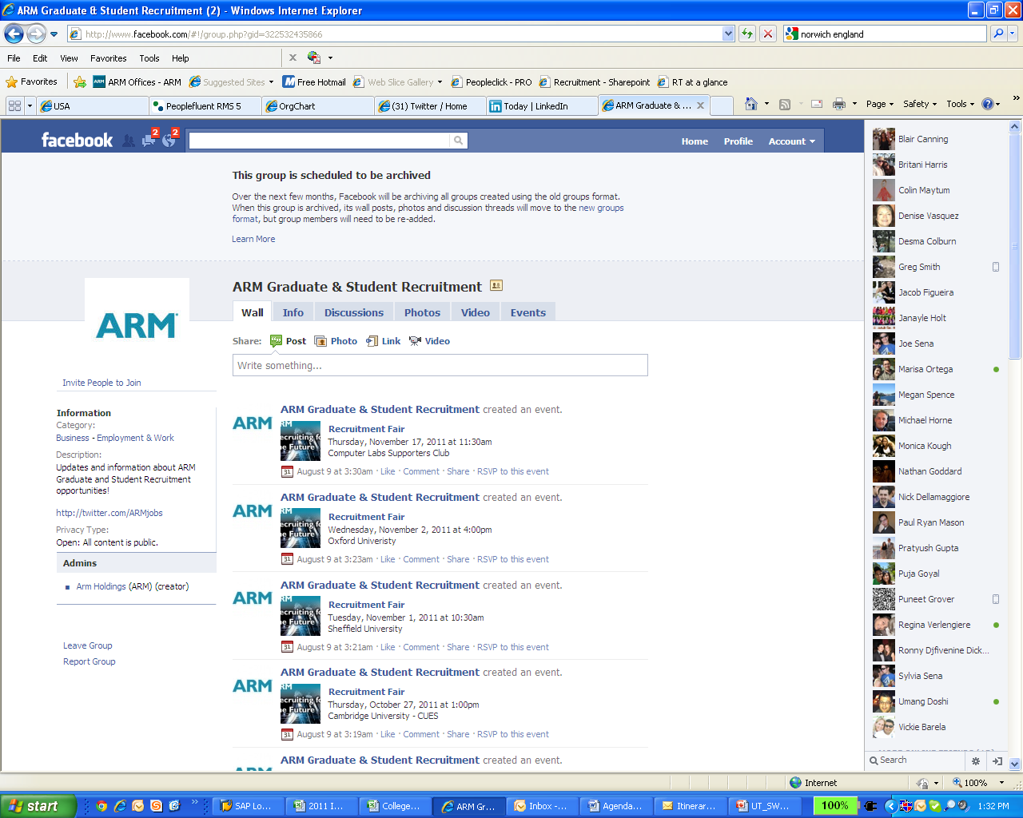
Your Future at ARM…
Graduate and Internship/Co-op Opportunities
Engineering: Memory, Validation, Performance, DFT, R&D, GPU and more!
Sales and Marketing: Corporate and Technical
Corporate: IT, Patents, Services (Training and Support), and Human Resources
Incredible Culture and Comprehensive Benefit Package
Competitive Reward
Work/Life Balance
Personal Development
Brilliant Minds and Innovative Solutions
Keep in Touch!
www.arm.com/about/careers

Slide 40
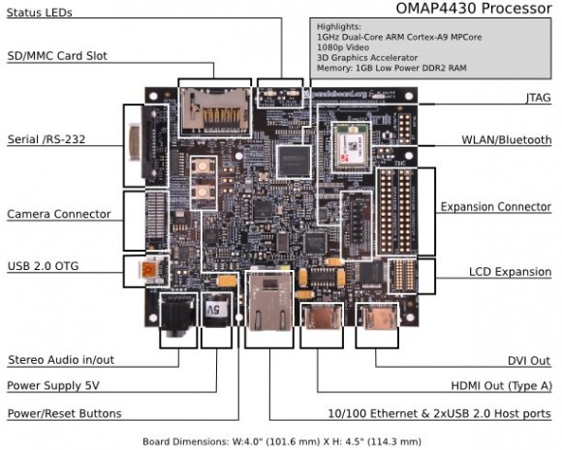
TI Panda Board
OMAP4430 Processor
1 GHz Dual-core ARM Cortex-A9 (NEON+VFP)
C64x+ DSP
PowerVR SGX 3D GPU
1080p Video Support
POP Memory
1 GB LPDDR2 RAM
USB Powered
< 4W max consumption (OMAP small % of that)
Many adapter options (Car, wall, battery, solar, ..)

Slide 41
Project Ideas Using Panda
OS Projects
OS porting to ARM/Cortex (TI OMAP)
MythTV system
“Super-Panda” – stack of Pandas as compute engine and task distribution
Linux applications
NEON Optimization Projects
Codec optimization in ffmpeg (pick your favorite codec)
Voice and image recognition
Open-source Flash player optimizations (swfdec)
Notes:
MythTV – free Linux app which turns computer into network streaming DVR, multimedia entertainment system, or home theater system.
FFmpeg – free program that records, converts, or streams digital audio and video in almost any format
Swfdec - free/open source replacement to the Adobe Flash web multimedia player

Slide 42

Fin
Notes:
FIN means “end” in French. It’s a mock of French Indie films who seem to think it’s kind of a “posh” way to end films.

Slide 43



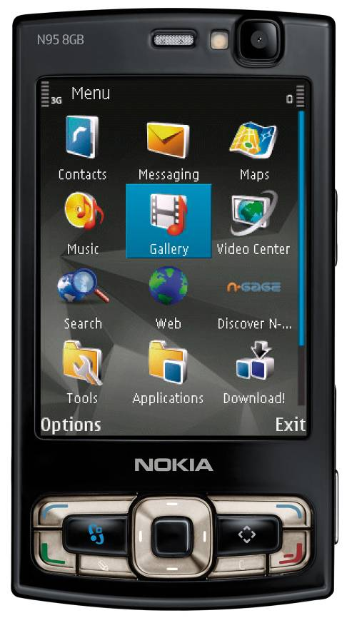






Nokia N95 Multimedia Computer
OMAP™ 2420 Applications Processor
ARM1136™ processor-based SoC, developed using Magma ® Blast® family and winner of 2005 INSIGHT Award for ‘Most Innovative SoC’
Symbian OS™ v9.2
Operating System supporting ARM processor-based mobile devices, developed using ARM® RealView® Compilation Tools
S60™ 3rd Edition
S60 Platform supporting ARM processor-based mobile devices
Mobiclip™ Video Codec
Software video codec for ARM processor-based mobile devices
ST WLAN Solution
Ultra-low power 802.11b/g WLAN chip with ARM9™ processor-based MAC
Connect. Collaborate. Create.
Notes:
43
SO here is a good example of an ARM-based product. The idea again is that there are a number of different companies involved in something like this, with ARM being at the core of the products, as well as other places too. For example, …
Magma EDA tools used for chip development, ie: synthesis, place and route, circuit simulation, verification, etc.
S60 is a multi-vendor standardized software platform for mobile phones from Nokia that runs on Symbian. It consists mainly of a suite of libraries and applications for doing things like telephony and multimedia. So Nokia licenses this to OEMs like LG and Samsung.

Slide 44
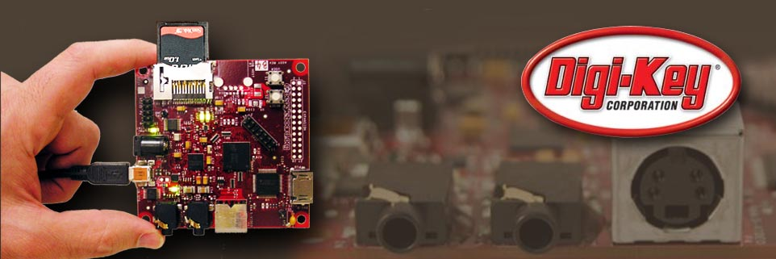

Beagle Board
Notes:
44
Now I want to talk a little bit about the Beagle Board, which is produced by a group at TI, and point out that this is just one of many boards out there, so this isn’t an attempt to sell you the board, but just to show you the latest technology based on ARM.

Slide 45


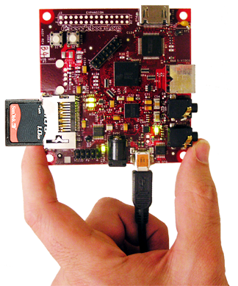
Targeting community development
$149
Wikis, blogs, promotion of community activity
Personally affordable
> 1000 participants and growing
Active & technical community
Freedom to innovate
Addressing open source community needs
Open access to hardware documentation
Instant access to >10 million lines of code
Opportunity to tinker and learn
Free software
Notes:
The Beagle is targeted at open source community development. It’s quite affordable at $149, and all the information, resources, and tools are all free. There’s a huge following for this board with very active communities and forums around it.

Slide 46

Fast, low power, flexible expansion
OMAP3530 Processor
600MHz Cortex-A8
NEON+VFPv3
16KB/16KB L1$
256KB L2$
430MHz C64x+ DSP
32K/32K L1$
48K L1D
32K L2
PowerVR SGX GPU
64K on-chip RAM
POP Memory
128MB LPDDR RAM
256MB NAND flash
Peripheral I/O
DVI-D video out
SD/MMC+
S-Video out
USB 2.0 HS OTG
I²C, I²S, SPI, MMC/SD
JTAG
Stereo in/out
Alternate power
RS-232 serial
3”
USB Powered
2W maximum consumption
OMAP is small % of that
Many adapter options
Car, wall, battery, solar, …

Slide 47
And more…
On-going collaboration at BeagleBoard.org
Live chat via IRC for 24/7 community support
Links to software projects to download
Other Features
4 LEDs
USR0
USR1
PMU_STAT
PWR
2 buttons
USER
RESET
4 boot sources
SD/MMC
NAND flash
USB
Serial
3”
Peripheral I/O
DVI-D video out
SD/MMC+
S-Video out
USB HS OTG
I²C, I²S, SPI, MMC/SD
JTAG
Stereo in/out
Alternate power
RS-232 serial
Notes:
Don’t re-read peripheral IO again (dupe from last slide)

Slide 48
Project Ideas Using Beagle
OS Projects
OS porting to ARM/Cortex (TI OMAP)
MythTV system
“Super-Beagle” – stack of Beagles as compute engine and task distribution
Linux applications
NEON Optimization Projects
Codec optimization in ffmpeg (pick your favorite codec)
Voice and image recognition
Open-source Flash player optimizations (swfdec)
Notes:
MythTV – free Linux app which turns computer into network streaming DVR, multimedia entertainment system, or home theater system.
FFmpeg – free program that records, converts, or streams digital audio and video in almost any format
Swfdec - free/open source replacement to the Adobe Flash web multimedia player

